Slide 1

Software Security
Overview

Slide 2
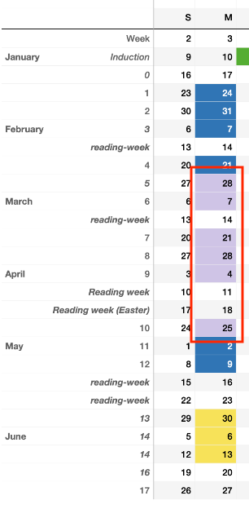
Practicalities
6 lecture slots
Planned for Monday 12:15 – 2:15
Weeks 5-10 inclusive
Associated lab exercises each week
Join #software-security channel on Slack
Assignment
Web application security report
Based on doing the labs
Choose a web app
Model threats
Add security features
Penetration test

Slide 3
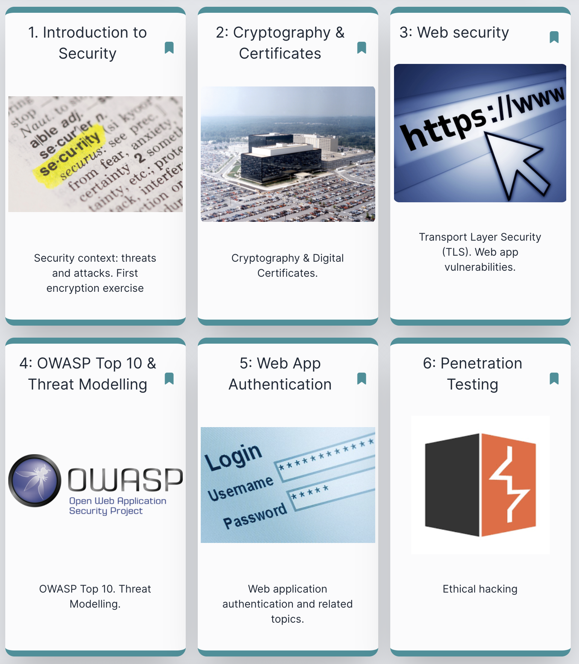
Main themes
Introduction
Threats, attacks, vulnerabilities; Security services
Cryptography & certificates
Symmetric & public-key encryption
Authentication and integrity
Key management and certificates
Web application security
TLS (SSL) deployment
Web app vulnerabilities & OWASP Top 10
Threat Modelling
Web app authentication
Secure key and password storage
Web authentication schemes
Ethical hacking: attack & defence
Penetration testing

Slide 4
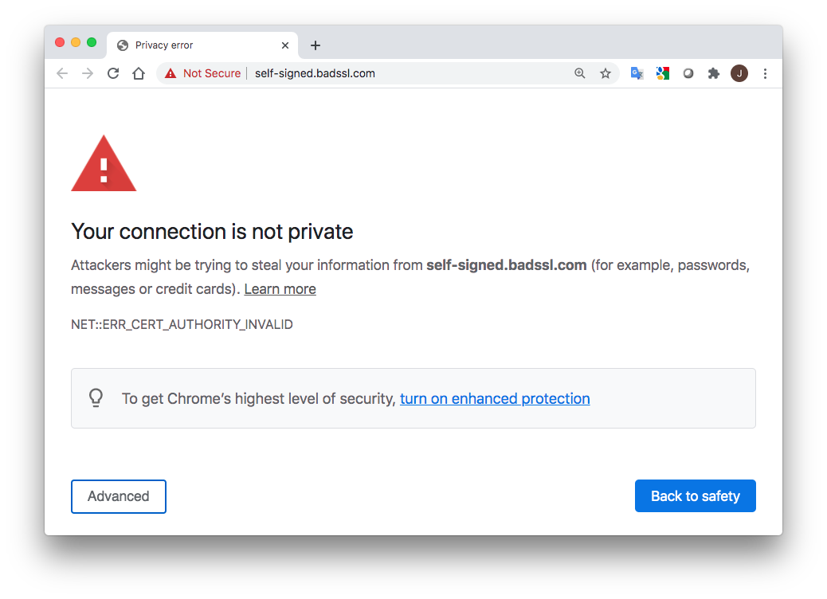
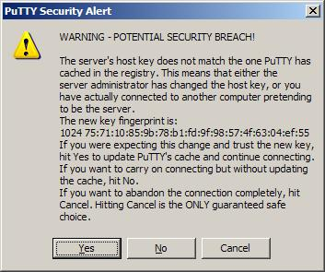
After this module, you should be able to
… understand warnings like these:

Slide 5
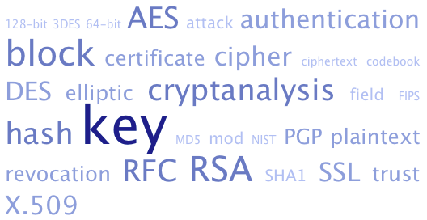
After this module, you should be able to
… follow crypto jargon:

Slide 6
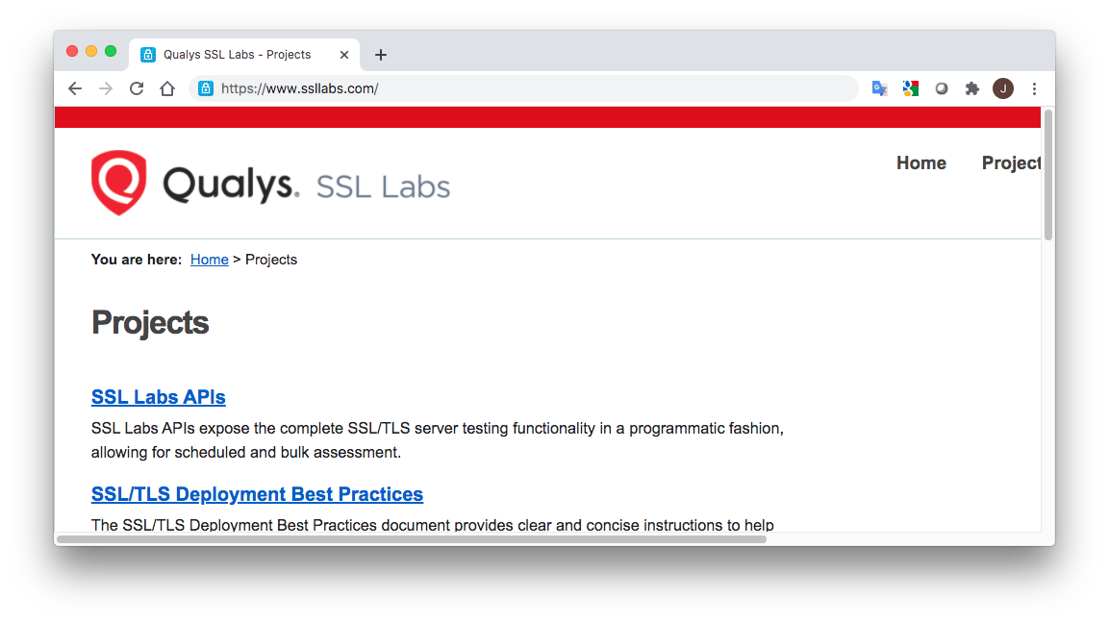
After this module, you should be able to
… set up TLS (https)

Slide 7
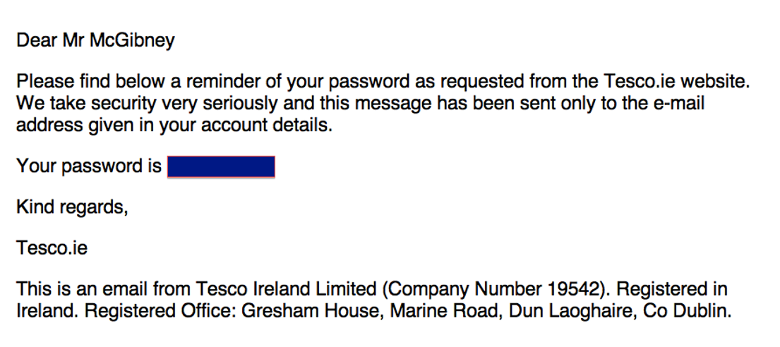
After this module, you should be able to
… understand why this is bad practice:
Note this is a historical example; Tesco has changed this practice

Slide 8
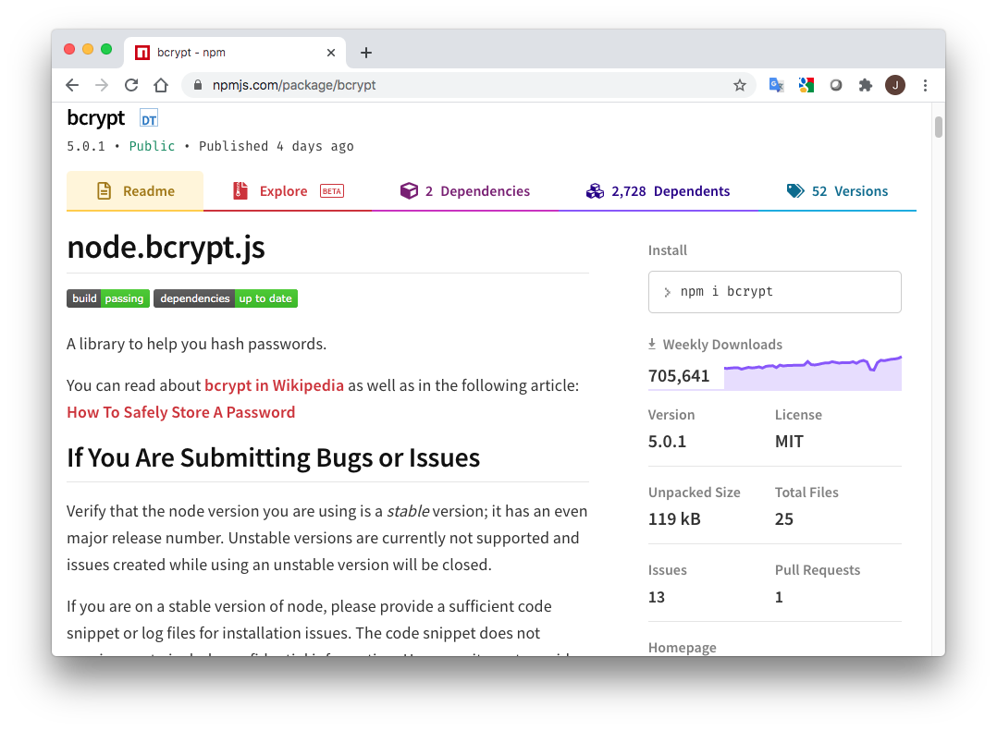
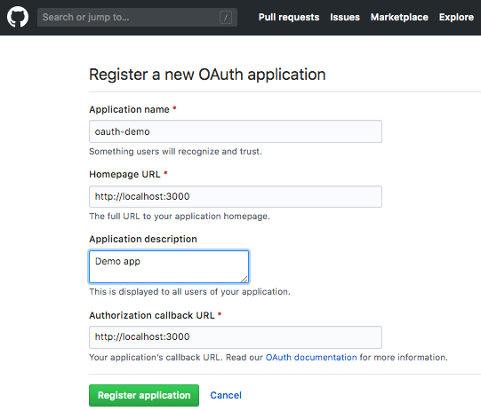
After this module, you should be able to
… use good authentication practices

Slide 9
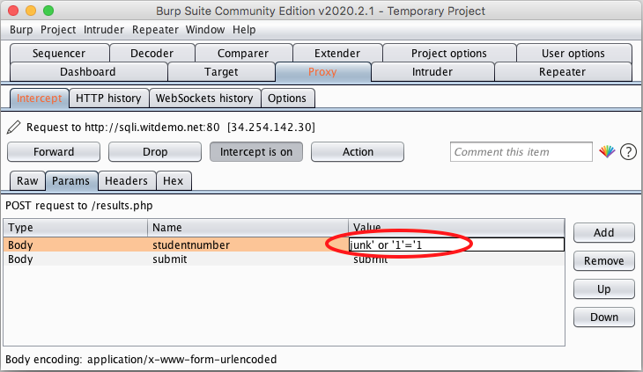
After this module, you should be able to
… do some penetration testing ("ethical hacking")

Slide 10
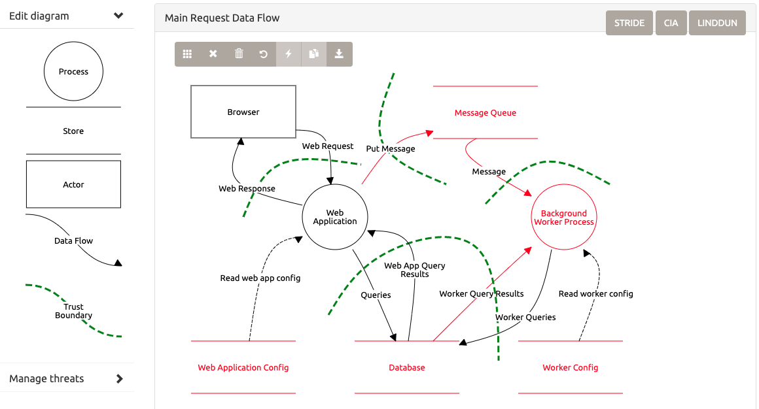
After this module, you should be able to
… do some threat modelling

Slide 11
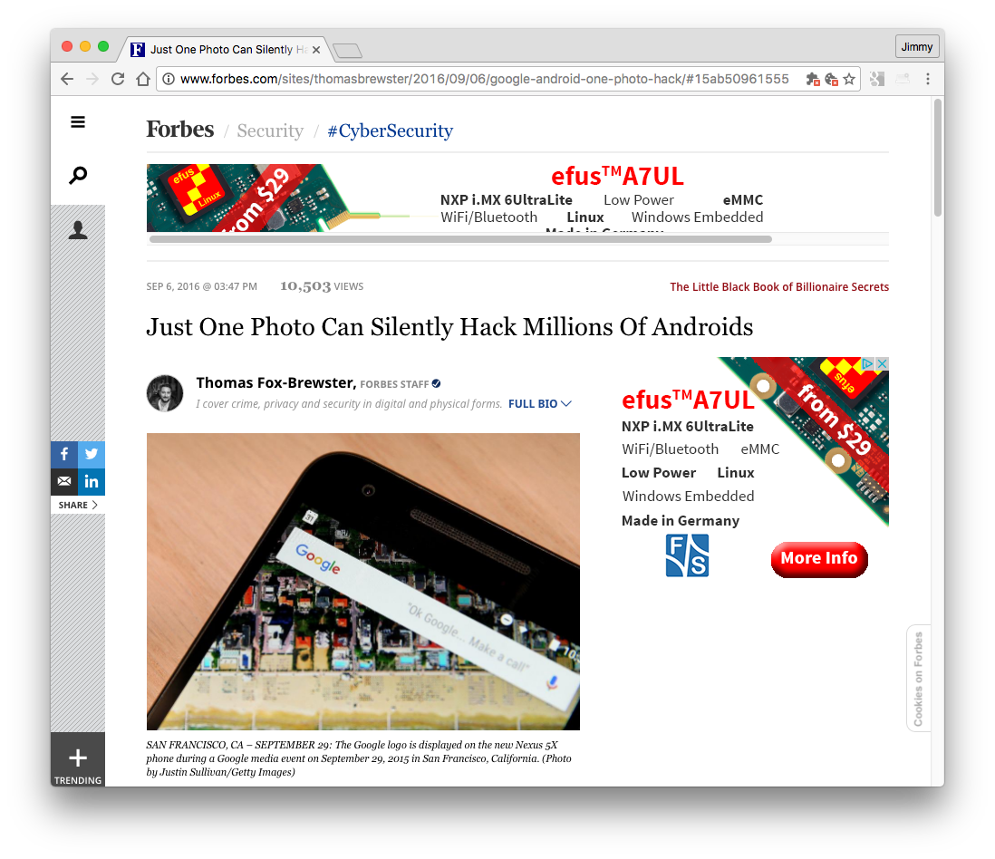
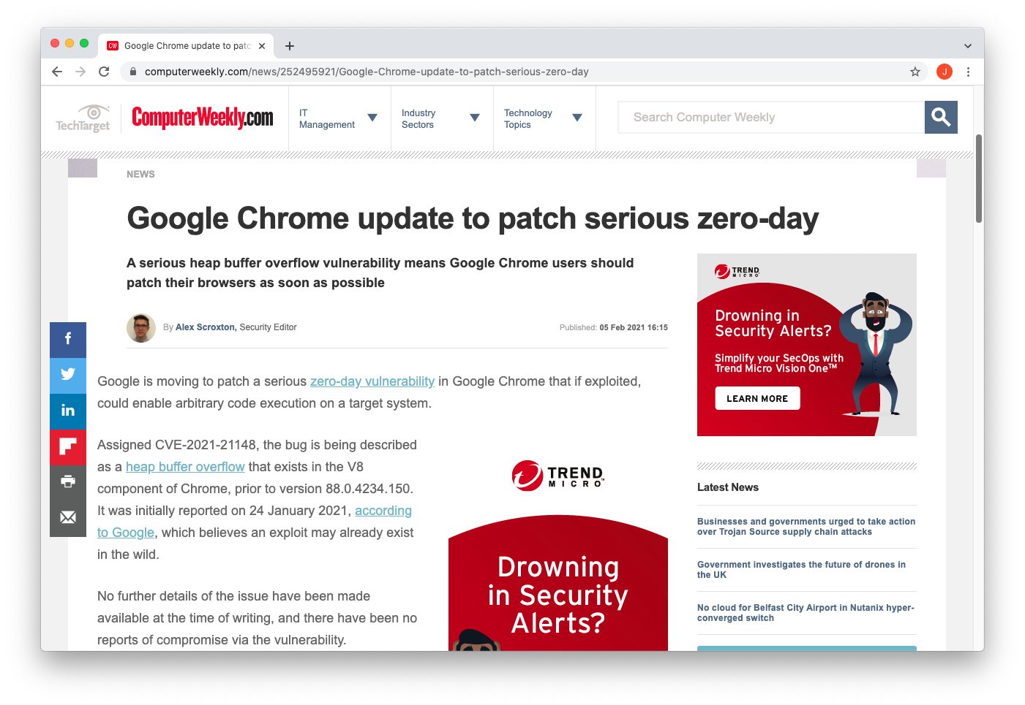
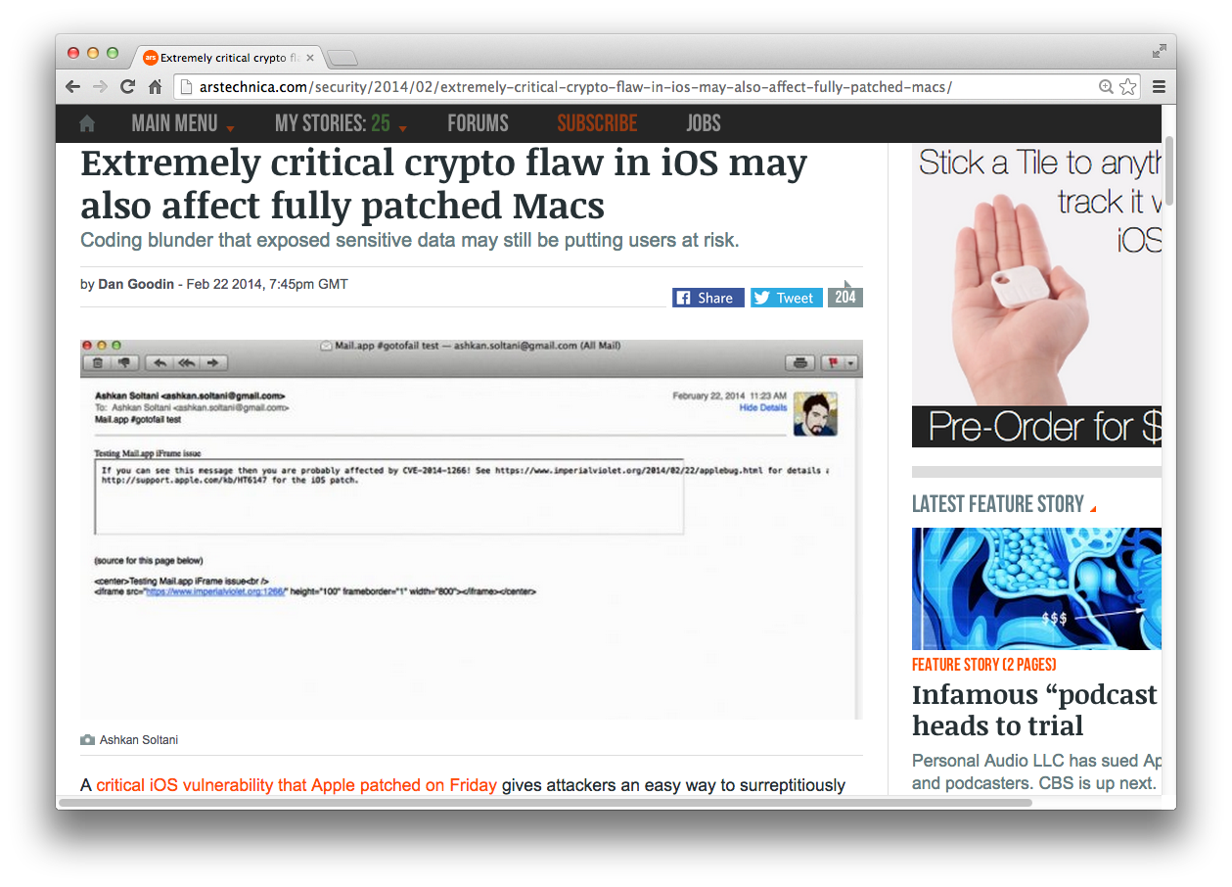
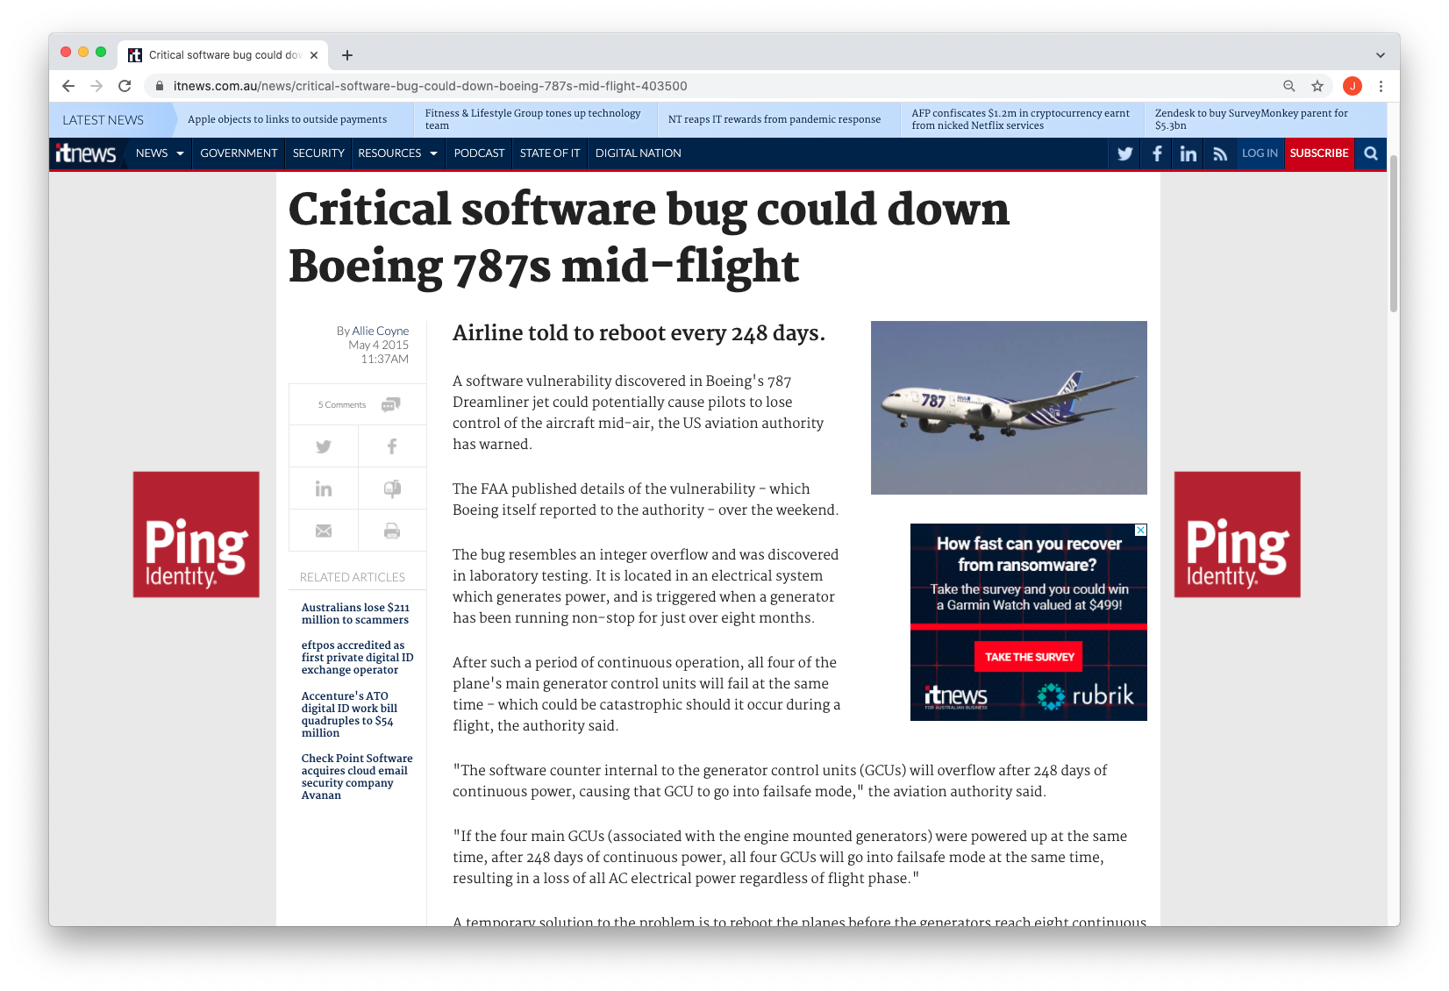
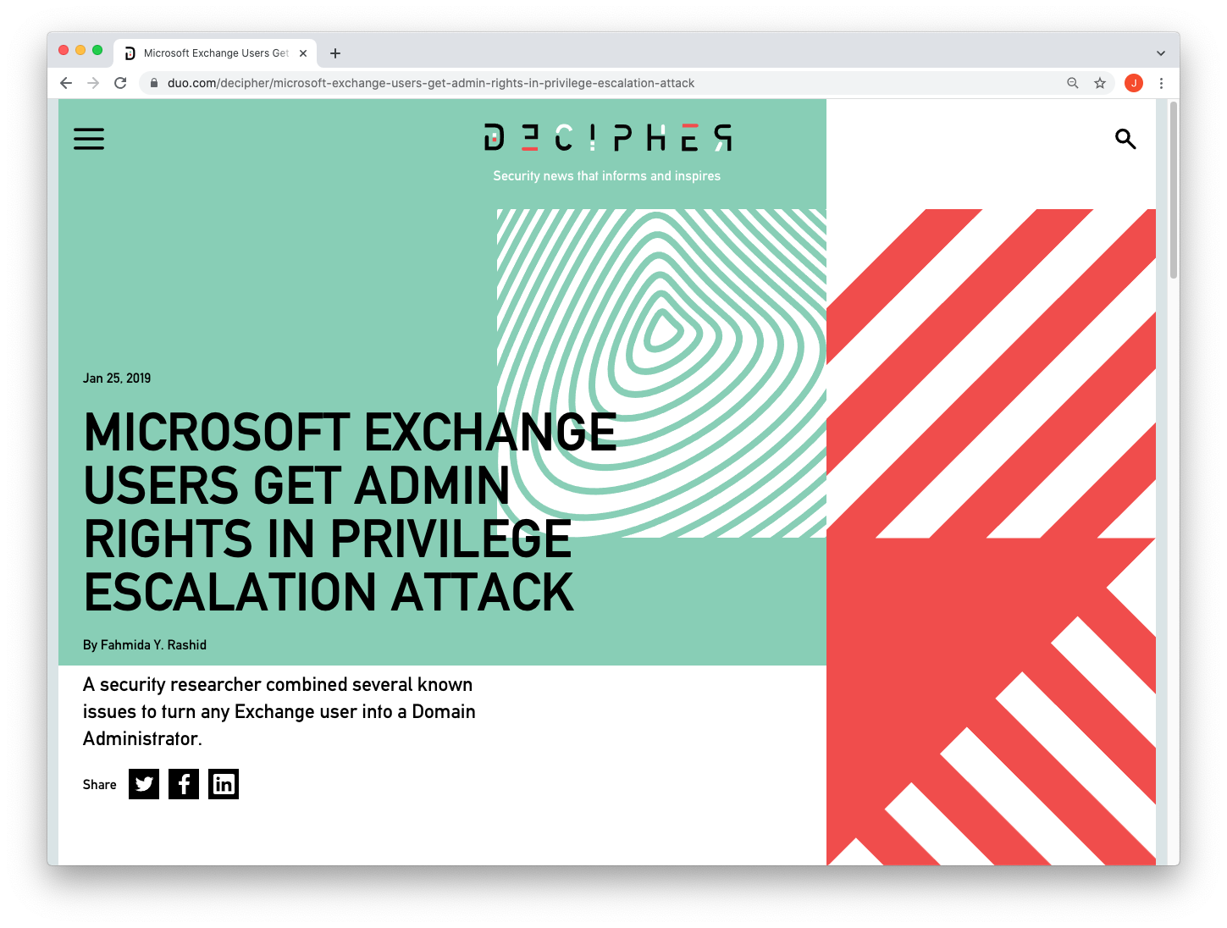
After this module, you should be able to
… better understand security news (and hype)

